Slide 1
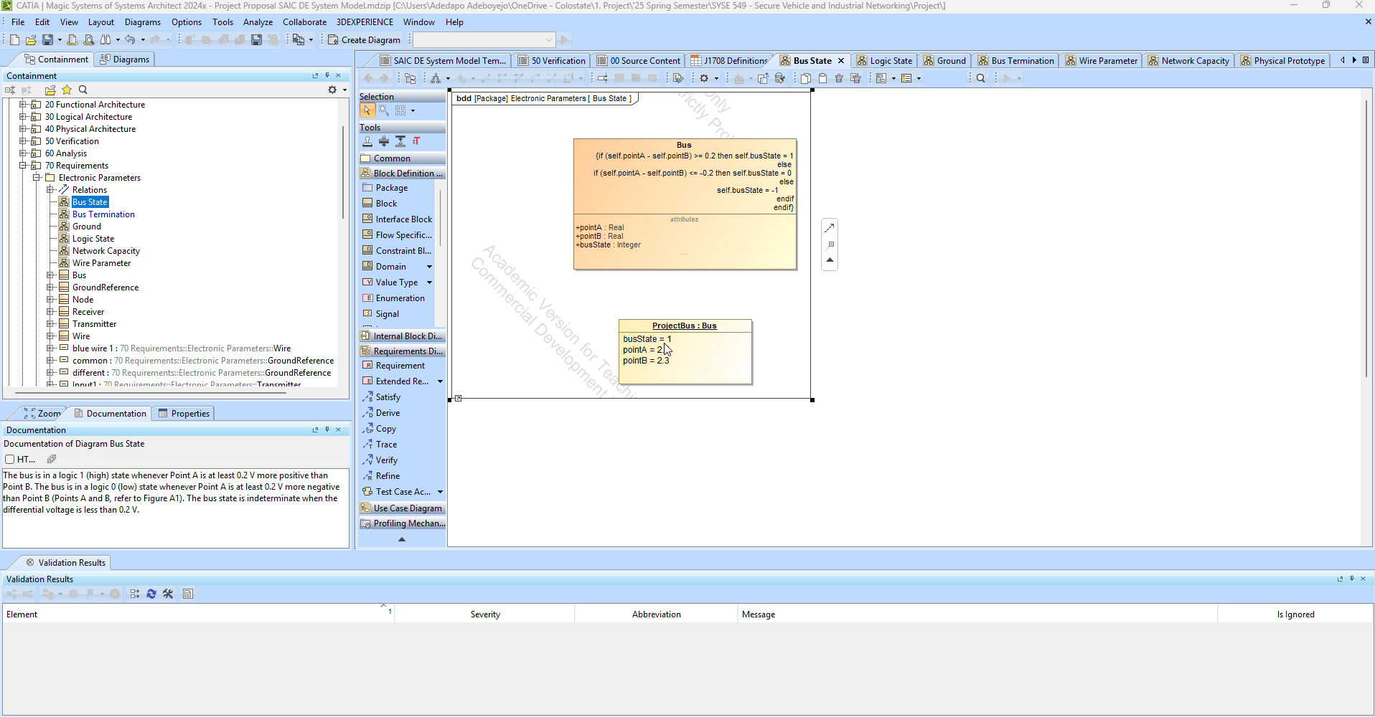
Example video of model validation

Slide 2
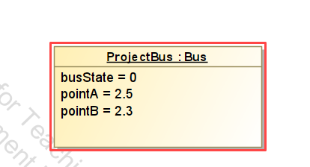
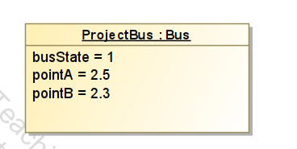
SAE J1708 Electronic Parameters
Rule Name | Description (SAE ) | OCL
Bus State Constraint | The bus is in a logic 1 (high) state whenever Point A is at least 0.2 V more positive than Point B. The bus is in a logic 0 (low) state whenever Point A is at least 0.2 V more negative than Point B (Points A and B, refer to Figure A1). The bus state is indeterminate when the differential voltage is less than 0.2 V. | if (self.pointA - self.pointB) >= 0.2 then self.busState = 1 else if (self.pointA - self.pointB) <= -0.2 then self.busState = 0 else self.busState = -1 endif endif
Notes:
What I just showed you was how a modeler would automatically validate if their model design was following the electronic parameter configurations provided by the SAE J1708 protocol. I demonstrated that the model can detect when the modeler doesn't follow custom validation rules that follow the protocol. In this case it was that the bus must be in a logic state of 1 if the difference in point A and B is .2V or greater.

Slide 3
SAE J1708 Electronic Parameters
Rule Name | Description (SAE ) | OCL
Bus State Constraint | The bus is in a logic 1 (high) state whenever Point A is at least 0.2 V more positive than Point B. The bus is in a logic 0 (low) state whenever Point A is at least 0.2 V more negative than Point B (Points A and B, refer to Figure A1). The bus state is indeterminate when the differential voltage is less than 0.2 V. | Context Bus inv BusStateConstraint: if (self.pointA - self.pointB) >= 0.2 then self.busState = 1 else if (self.pointA - self.pointB) <= -0.2 then self.busState = 0 else self.busState = -1 endif endif
Notes:
I was able to do enforce these Electronic Parameter "constraints" in about 6 out of 9 of the parameters given in the protocol document. An interesting aspect of our methodology is that I used AI (Google Gemini) to help generate validation rules, and then I had to build and troubleshoot the implementation in CATIA, making iterative changes to get it to work properly.
Ultimately, we received feedback that modeling low-level electronic parameters is too restrictive for practical application and limits design choices. We're shifting focus to the transport/application layers (message content, structure, timing). This level allows for meaningful modeling but requires managing protocol ambiguities. So, we'll leverage existing J1939 research, apply it to J1587, and develop model validations to help Systems Engineers create secure designs to mitigate known exploits." - This is our proof of concept.
-rewrite

Slide 4
Mitigation Strategy -> Model Validation Example
Vulnerability | Mitigation | OCL Validation ex.
Malicious CTS (Chatterjee, et Al 2023) | The apparent mitigation against this attack is to ensure invalid CTS messages as used in the attack are ignored. (Chatterjee, et Al 2023) | context ClassName inv validNextPacket: nextPacket <= totalPackets
Notes:
We aim to test and evaluate those vulnerabilities and subsequently model the mitigation strategies. For example, their could be a model validation for the Malicious CTS exploit and mitigation strategy demonstrated by Rik Chatterjee.

Slide 5
Mitigation Strategy -> Model Validation Example
Vulnerability | Mitigation | OCL Validation ex.
Malicious CTS (Chatterjee, et Al 2023) | The apparent mitigation against this attack is to ensure invalid CTS messages as used in the attack are ignored. (Chatterjee, et Al 2023) | context ClassName inv validNextPacket: nextPacket <= totalPackets
Notes:
Example mitigation from our class assignment was nextpacket <= total Packets. I've been the OCL equivalent to illustrate what could work, I haven't built it out yet.
To tie it all together - The quote from earlier was that "When a model passes validation, you KNOW it is compliant",
We've demonstrated a model validation for electronic parameters. Well now our proof of concept will show how Systems Engineer modelers can implement a validation suite in their design, to be compliant to researched mitigation strategies."

